Slide 1

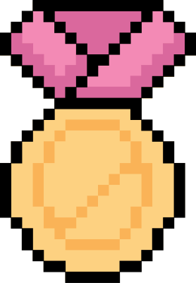




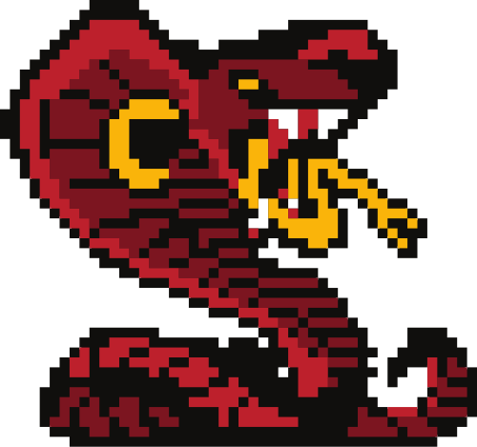


Snake ‘N’ Shake
by Deepali, Mitesh, Krishna

Slide 2





How to Play?
It’s simple and fun to play!
Guidelines are below!
01.
02.
03.
Press the S button and the
game starts!
Try to make the snake
as long as possible!
Snake will die upon eating
itself or going out of bounds!

Slide 3



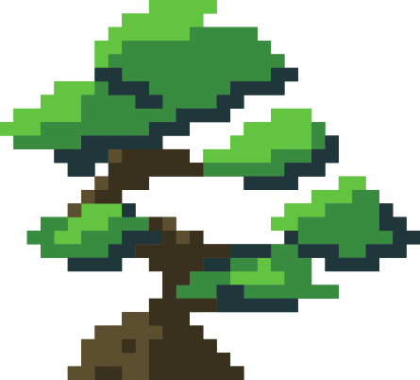

Are you ready?
Let’s Get started!

Slide 4


Data structures used!
Concept of Dynamic arrays is used for creating snake body and internally python list is being used.

Slide 5




Why Dynamic array?
Dynamic arrays are a linear data structure which can grow to any size as per user’s desire by resizing themselves once the capacity is met.
Since the snake’s body grows as it eats fruits and it’s entire body moves together, dynamic arrays are best for it’s implementation!

Slide 6





Code details!
Number of code files - 5
main.py
scoreboard.py
lives.py
snake.py
food.py

Slide 7
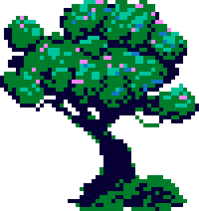
The details of implementation
is in the code documentation file

Slide 8



In short!
Scoreboard.py is the file which maintains the scoreboard.
Food.py has the code which maintains the food of the snake.
Snake.py is the code for running the body of the snake, increasing it’s size etc.
Lives.py maintains the lives of the snake.
Main.py is the main file which will run the game.

Slide 9
Key game components!
Movement
Growth
Collision
Detection

Slide 10

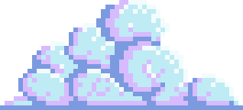




Learnings!
With only the knowledge of dynamic arrays and some GUI we can build such a nice game!
Maintaining different files for each component makes the code clean and easy to debug.
Documenting the project helps in revising the entire code once again quickly and helps others to understand the code!

Slide 11
Thankyou for playing

